Slide 1

Extension of the SWIFT option pricing scheme for European options calibration under Heston stochastic volatility model
Master in Advanced Mathematics and Mathematical Engineering
Master's thesis
Supervised by Luis Ortiz-Gracia
Eudald Romo Grau
July 2020
Notes:
This study extends the SWIFT option pricing scheme to option contracts calibration, specifically, under Heston stochastic volatility dynamics.
1 (4m) 2 ()

Slide 2
Motivation
1
Challenges in option contracts trading.
Notes:
This has direct applications to real-market options trading, so it is interesting to know why both calibration and the Heston model are relevant for that.

Slide 3
Option Trading Cycle
Fetch
Option Prices
Tune
Model
Send
Orders
Set
Option
Prices
Notes:
Why calibration is relevant can be seen from a simplified option trading cycle, where one starts by fetching option market prices and uses them to tune certain option dynamics model. Then, this model is used to give prices to all relevant options and this information is finally used to decide a course of action given a certain investing strategy.

Slide 4
Option Trading Cycle
Market data
Fetch
Option Prices
Tune
Model
Get the required option and underlying asset data.
Send
Orders
Set
Option
Prices
Notes:
Let’s look at each node more closely. Given a certain contracts exchange market one can retrieve option market prices for each product one is interested in. This is typically automated through market data fetching software that, from my experience in options trading, can typically take just dozens of microseconds.

Slide 5
Option Trading Cycle
Market data
Fetch
Option Prices
Tune
Model
Option calibrator
Get the required option and underlying asset data.
Choose model parameters that fit the prices of a set of strikes and maturities.
Send
Orders
Set
Option
Prices
Notes:
Then, one can calibrate the option dynamics model to fit the prices of a previously defined set of strikes and maturities. This step is typically computationally expensive and can easily become a bottleneck in the process.

Slide 6
Option Trading Cycle
Market data
Fetch
Option Prices
Tune
Model
Option calibrator
Get the required option and underlying asset data.
Choose model parameters that fit the prices of a set of strikes and maturities.
Send
Orders
Set
Option
Prices
Option pricer
Use the calibrated model all the options of interest.
Notes:
Once the model is calibrated, it can be used to price the rest of the options of interest. The calibration step usually includes several pricing iterations on a reduced number of options, as will be seen later, so this step doesn’t tend to be a bottleneck.

Slide 7
Option Trading Cycle
Market data
Fetch
Option Prices
Tune
Model
Option calibrator
Get the required option and underlying asset data.
Choose model parameters that fit the prices of a set of strikes and maturities.
Investing strategy
Send
Orders
Set
Option
Prices
Option pricer
Decide how to react to the current theoretic prices and inform the exchange.
Use the calibrated model all the options of interest.

Slide 8
Option Trading Cycle
Market data
Fetch
Option Prices
Tune
Model
Option calibrator
Get the required option and underlying asset data.
Choose model parameters that fit the prices of a set of strikes and maturities.
Investing strategy
Send
Orders
Set
Option
Prices
Option pricer
Decide how to react to the current theoretic prices and inform the exchange.
Use the calibrated model all the options of interest.

Slide 9
Option Pricing
2
Risk-neutrality applied to European options.
Notes:
In order to see why the Heston model or the SWIFT method are relevant I need to first delve into how options are typically priced, in particular how European options are priced.

Slide 10
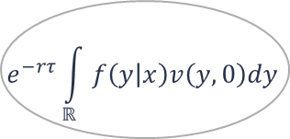
European Option Price
Risk-neutral
assumption
Option payoff
$$e^{−rτ}\int_{ℝ}{f\left(y | x\right)v\left(y,0\right)dy}$$
State variable
choice
Underlying
asset
model
Notes:
In the middle, you can see the risk-neutral European option price formula, and around it are the four key concepts that define it.

Slide 11
European Option Price
Risk-neutral
assumption
Option payoff
$$e^{−rτ}\int_{ℝ}{f\left(y | x\right)v\left(y,0\right)dy}$$
State variable
choice
Underlying
asset
model
Notes:
First, if one assumes that there are no arbitrage opportunities, one can consider the market as risk-neutral. Under this assumption, the price of the option is the expected payoff under the risk-neutral metric discounted at the risk-free rate r.

Slide 12
European Option Price
Risk-neutral
assumption
Option payoff
$$e^{−rτ}\int_{ℝ}{f\left(y | x\right)v\left(y,0\right)dy}$$
State variable
choice
Underlying
asset
model
Notes:
The payoff is the benefit obtained from exercising the option contract. European options can only be exercised on expiry, so their payoff can simply be stated as a function of the final state of the option, y.

Slide 13
European Option Price
Risk-neutral
assumption
Option payoff
$$e^{−rτ}\int_{ℝ}{f\left(y | x\right)v\left(y,0\right)dy}$$
State variable
choice
Underlying
asset
model
Notes:
The expectation under the risk-neutral metric is defined by the underlying asset price evolution model, which appears in the formula as the probability function of the final state of the underlying asset y, conditioned to initial state x.

Slide 14
European Option Price
Risk-neutral
assumption
Option payoff
$$e^{−rτ}\int_{ℝ}{f\left(y | x\right)v\left(y,0\right)dy}$$
State variable
choice
Underlying
asset
model
Notes:
Both the underlying asset final state probability distribution and the payoff expressions depend on the underlying asset state variables used, in the thesis the benefits of logarithmic state variables is shown.

Slide 15
Underlying asset models
3
Why is Heston stochastic model relevant?

Slide 16
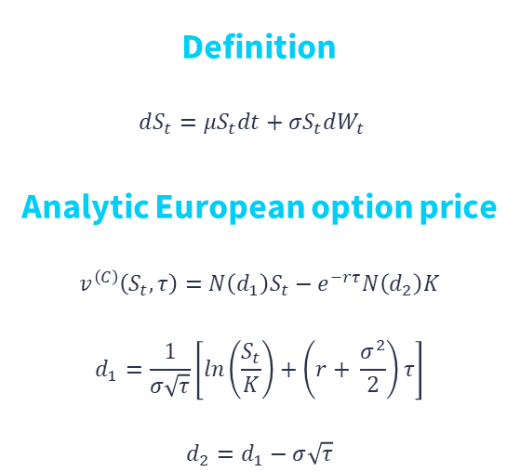
Black-Scholes-Merton model
Definition
$$dS_{t}=μS_{t}dt+σS_{t}dW_{t}$$
Analytic European option price
$$v^{\left(C\right)}\left(S_{t},τ\right)=N\left(d_{1}\right)S_{t}−e^{−rτ}N\left(d_{2}\right)K$$
$$d_{1}=\frac{1}{σ\sqrt{τ}}\left[ln\left(\frac{S_{t}}{K}\right)+\left(r+ \frac{σ^{2}}{2}\right)τ\right]$$
$$d_{2}=d_{1}−σ\sqrt{τ}$$
Notes:
An underlying asset model typically used is the Black-Scholes-Merton model, which assumes the underlying asset prices follow a geometric Brownian motion.

Slide 17
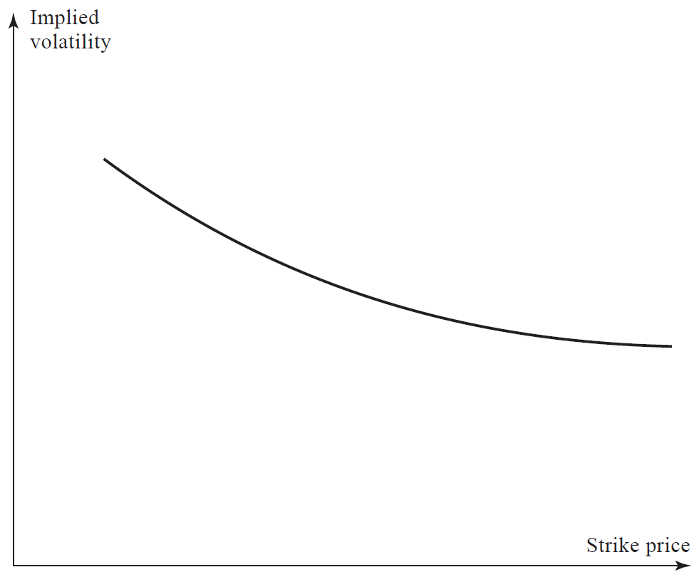
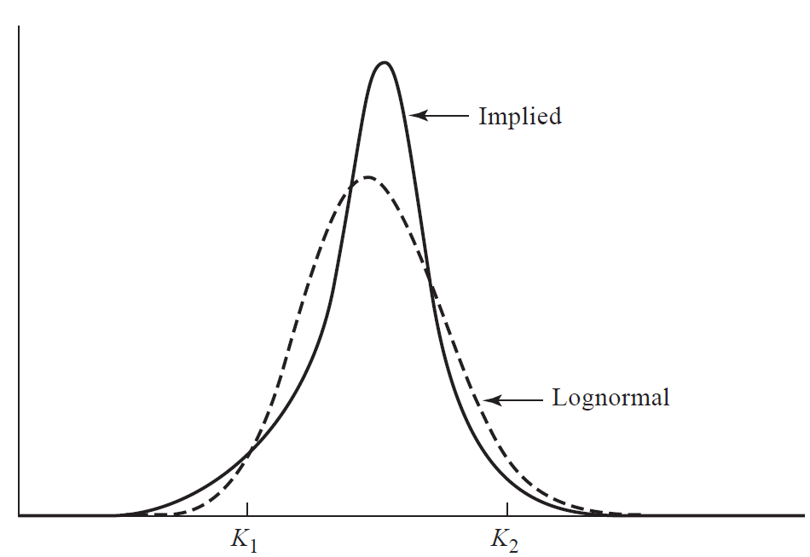
Volatility Smile
Notes:
Talk about volatility surface too. In particular about term structure.

Slide 18
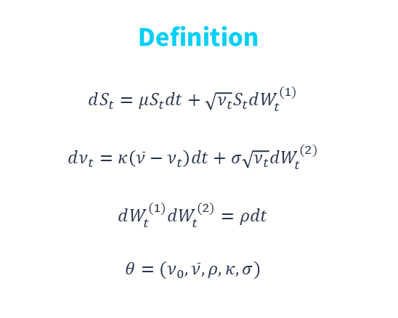
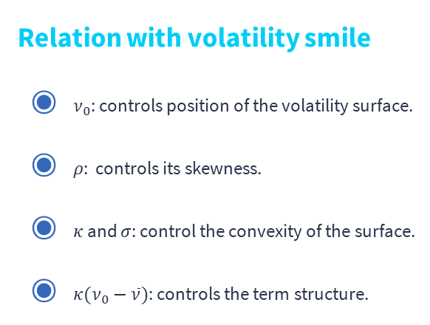
Heston model
Definition
$$dS_{t}=μS_{t}dt+\sqrt{ν_{t}}S_{t}dW_{t}^{(1)}$$
$$dν_{t}=κ\left(\overline{ν}−ν_{t}\right)dt+σ\sqrt{ν_{t}}dW_{t}^{(2)}$$
$$dW_{t}^{(1)}dW_{t}^{(2)}=ρdt$$
$$θ=(ν_{0},\overline{ν},ρ,κ,σ)$$
Relation with volatility smile
$ν_{0}$: controls position of the volatility surface.
$ρ$: controls its skewness.
$κ$ and $σ$: control the convexity of the surface.
$κ(ν_{0}−\overline{ν})$: controls the term structure.

Slide 19
Characteristic function expressions
Heston
Discontinuous
Complicated gradient
Schoutens
Continuous
Complicated gradient
Del Baño-Rollin
Discontinuous
Simple gradient
Cui
Continuous
Simple gradient
Notes:
Explain how, prior to the last expression, gradient-based methods were rarely used, and their alternatives were either really slow, or just slow but imposed assumptions on the parameters that limited their full domain, risking leaving the optimum out.

Slide 20
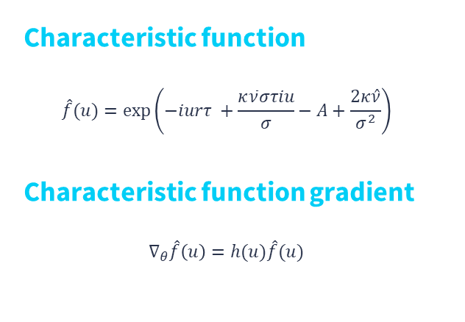
Cui’s expression
Characteristic function
$$\hat{f}(u)=\exp\left(−iurτ +\frac{κ\overline{ν}στiu}{σ}−A+\frac{2κ\hat{ν}}{σ^{2}}\right)$$
Characteristic function gradient
$$∇_{θ}\hat{f}\left(u\right)=h(u)\hat{f}(u)$$

Slide 21
European Option Pricing
4
What advantages does SWIFT provide?

Slide 22
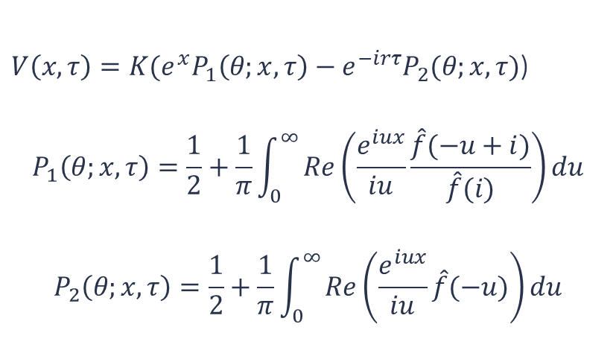
Heston formula
$V\left(x,τ\right)=K(e^{x}P_{1}\left(θ;x,τ\right)−e^{−irτ}P_{2}(θ;x,τ)$)
$$P_{1}\left(θ;x,τ\right)=\frac{1}{2}+\frac{1}{π}\int_{0}^{∞}{Re\left(\frac{e^{iux}}{iu}\frac{\hat{f}(−u+i)}{\hat{f}(i)}\right)}du$$
$$P_{2}\left(θ;x,τ\right)=\frac{1}{2}+\frac{1}{π}\int_{0}^{∞}{Re\left(\frac{e^{iux}}{iu}\hat{f}(−u)\right)}du$$
Notes:
This can be extended to other models outside from Heston.

Slide 23
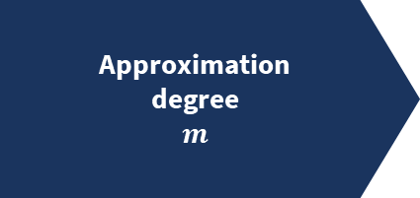
MRA and Shannon wavelets
Approximation
degree
$m$
Notes:
Maybe add a slide with sinc and its fourier transform.`````````````````

Slide 24

MRA and Shannon wavelets
Approximation
degree
$m$
Family of functions
$$φ_{m,k}$$
Notes:
Maybe add a slide with sinc and its fourier transform.`````````````````

Slide 25
MRA and Shannon wavelets
Approximation
degree
$m$
Family of functions
$$φ_{m,k}$$
Function
projection
Notes:
Maybe add a slide with sinc and its fourier transform.`````````````````

Slide 26
MRA and Shannon wavelets
Approximation
degree
$m$
Family of functions
$$φ_{m,k}$$
Function
projection
Sinc
function
Notes:
Maybe add a slide with sinc and its fourier transform.`````````````````

Slide 27
MRA and Shannon wavelets
Approximation
degree
$m$
Family of functions
$$φ_{m,k}$$
Function
projection
Sinc
function
Shannon
wavelets
Notes:
Maybe add a slide with sinc and its fourier transform.`````````````````

Slide 28
MRA and Shannon wavelets
Approximation
degree
$m$
Family of functions
$$φ_{m,k}$$
Function
projection
Sinc
function
Shannon
wavelets
Compact and
simple Fourier
transform
Notes:
Maybe add a slide with sinc and its fourier transform.`````````````````

Slide 29
MRA and Shannon wavelets
Approximation
degree
$m$
Family of functions
$$φ_{m,k}$$
Function
projection
Sinc
function
Shannon
wavelets
Compact and
simple Fourier
transform
Notes:
Maybe add a slide with sinc and its fourier transform.`````````````````

Slide 30
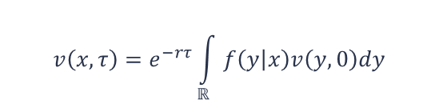
SWIFT
Wavelet projection
Series truncation
$$v\left(x,τ\right)=e^{−rτ}\int_{ℝ}{f\left(y | x\right)v\left(y,0\right)dy}$$
Density coefficients approximation
Payoff coefficients approximation

Slide 31
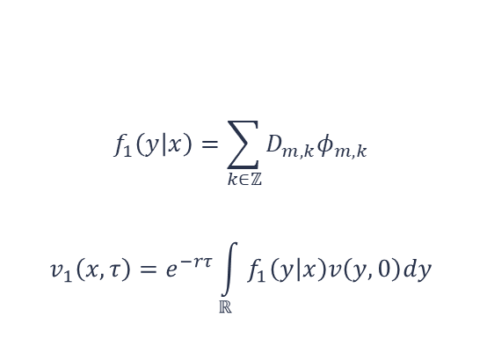
SWIFT
Wavelet projection
$$f_{1}\left(y | x\right)=\sum_{k∈ℤ}{D_{m,k}φ_{m,k}}$$
$$v_{1}\left(x,τ\right)=e^{−rτ}\int_{ℝ}{f_{1}\left(y | x\right)v\left(y,0\right)dy}$$
Series truncation
Density coefficients approximation
Payoff coefficients approximation

Slide 32
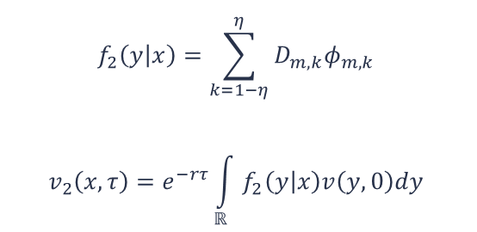
SWIFT
Wavelet projection
$$f_{2}\left(y | x\right)=\sum_{k=1−η}^{η}{D_{m,k}φ_{m,k}}$$
$$v_{2}\left(x,τ\right)=e^{−rτ}\int_{ℝ}{f_{2}\left(y | x\right)v\left(y,0\right)dy}$$
Series truncation
Density coefficients approximation
Payoff coefficients approximation

Slide 33
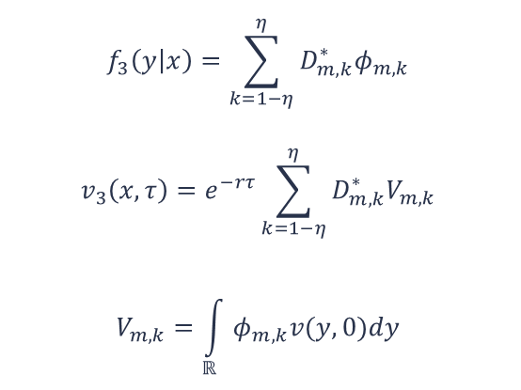
SWIFT
Wavelet projection
$$f_{3}\left(y | x\right)=\sum_{k=1−η}^{η}{D_{m,k}^{∗}φ_{m,k}}$$
$$v_{3}\left(x,τ\right)=e^{−rτ}\sum_{k=1−η}^{η}{D_{m,k}^{∗}V_{m,k}}$$
$$V_{m,k}=\int_{ℝ}{φ_{m,k}v(y,0)dy}$$
Series truncation
Density coefficients approximation
Payoff coefficients approximation

Slide 34
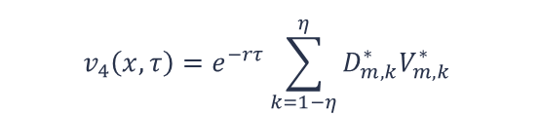
SWIFT
Wavelet projection
Series truncation
$$v_{4}\left(x,τ\right)=e^{−rτ}\sum_{k=1−η}^{η}{D_{m,k}^{∗}V_{m,k}^{∗}}$$
Density coefficients approximation
Payoff coefficients approximation
Notes:
Discuss how SWIFT provides methods to choose the parameters

Slide 35
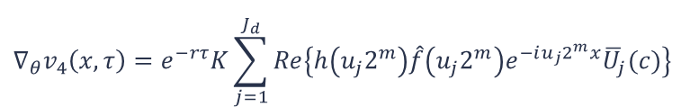
New contributions
Gradient computation
Invariant parameters assumption.
Alternative SWIFT formulation for multiple strikes
$${∇_{θ}v}_{4}\left(x,τ\right)=e^{−rτ}K\sum_{j=1}^{J_{d}}{Re\left\{h\left(u_{j}2^{m}\right)\hat{f}\left(u_{j}2^{m}\right)e^{−iu_{j}2^{m}x}{\overline{U}}_{j}(c)\right\}}$$

Slide 36
New contributions
Gradient computation
Invariant parameters assumption.
Alternative SWIFT formulation for multiple strikes
Speed-up techniques
Extension of previous techniques to the gradient computation.
Reusing computations through all calibration steps.
Reusing computations between price and gradient.
$${∇_{θ}v}_{4}\left(x,τ\right)=e^{−rτ}K\sum_{j=1}^{J_{d}}{Re\left\{h\left(u_{j}2^{m}\right)\hat{f}\left(u_{j}2^{m}\right)e^{−iu_{j}2^{m}x}{\overline{U}}_{j}(c)\right\}}$$

Slide 37
Option calibration
5
Minimization problem approach

Slide 38
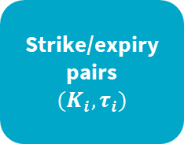
What is a calibrated model?
Strike/expiry
pairs
$${(K}_{i},τ_{i})$$

Slide 39
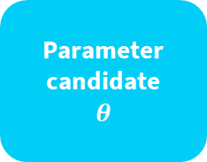
What is a calibrated model?
Fetch
market
data
Strike/expiry
pairs
$${(K}_{i},τ_{i})$$
Parameter
candidate
$$θ$$

Slide 40
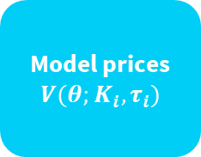
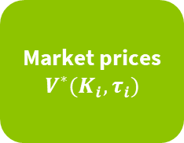
What is a calibrated model?
Fetch
market
data
Market prices
$$V^{∗}(K_{i},τ_{i})$$
Strike/expiry
pairs
$${(K}_{i},τ_{i})$$
Parameter
candidate
$$θ$$
Model prices
$$V(θ;K_{i},τ_{i})$$

Slide 41
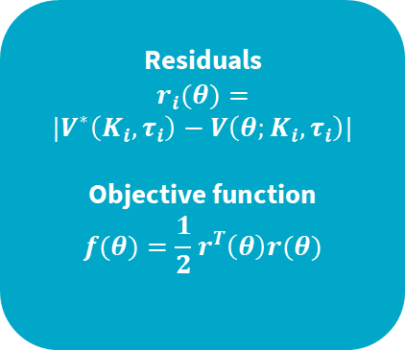
What is a calibrated model?
Fetch
market
data
Market prices
$$V^{∗}(K_{i},τ_{i})$$
Residuals
$$r_{i}(θ)=$$
$$|V^{∗}\left(K_{i},τ_{i}\right)−V\left(θ;K_{i},τ_{i}\right)|$$
Objective function
$$f(θ)=\frac{1}{2}r^{T}\left(θ\right)r(θ)$$
Strike/expiry
pairs
$${(K}_{i},τ_{i})$$
Parameter
candidate
$$θ$$
Model prices
$$V(θ;K_{i},τ_{i})$$

Slide 42
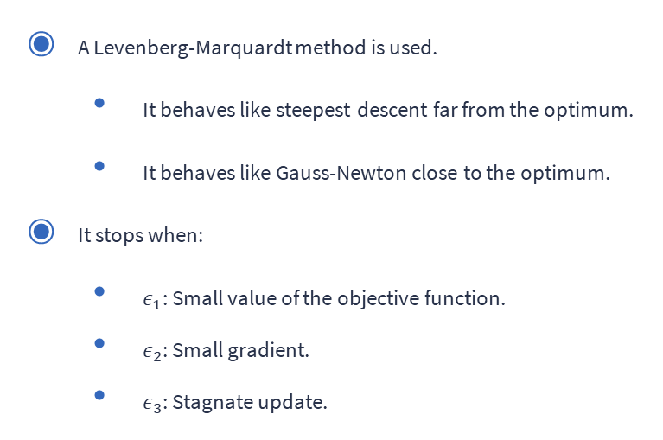
How is the optimum reached?
A Levenberg-Marquardt method is used.
It behaves like steepest descent far from the optimum.
It behaves like Gauss-Newton close to the optimum.
It stops when:
$ε_{1}$: Small value of the objective function.
$ε_{2}$: Small gradient.
$ε_{3}$: Stagnate update.

Slide 43
Numerical results
6
Let’s start with the first set of slides

Slide 44

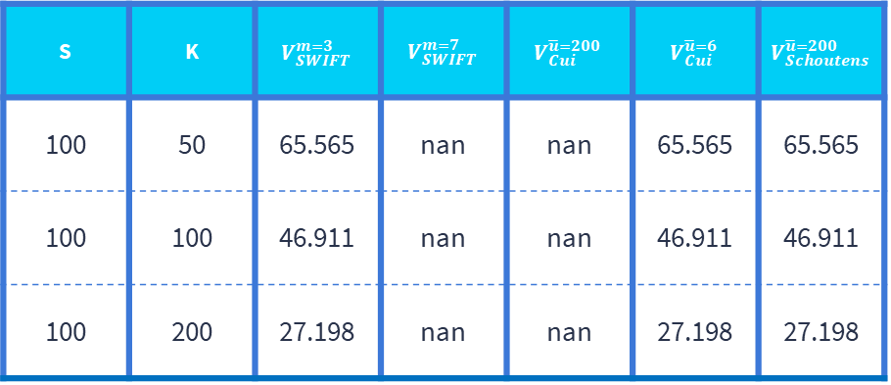
Stress Tests. $τ=45$ years.
S | K | $$V_{SWIFT}^{m=3}$$ | $$V_{SWIFT}^{m=7}$$ | $$V_{Cui}^{\overline{u}=200}$$ | $$V_{Cui}^{\overline{u}=6}$$ | $$V_{Schoutens}^{\overline{u}=200}$$
100 | 50 | 65.565 | nan | nan | 65.565 | 65.565
100 | 100 | 46.911 | nan | nan | 46.911 | 46.911
100 | 200 | 27.198 | nan | nan | 27.198 | 27.198

Slide 45
Speed Tests
 | 40 strikes x 1 expiry | 8 strikes x 5 expiries | 8 strikes x 5 expiries (disabling reusable data across strikes)
SWIFT (no speed-ups) | 7s | 36s | [36s]
SWIFT (with speed-ups) | 4.5ms | 45ms | 170ms
Comparison test | 46ms | 63ms | [63ms]
Notes:
No speedups meant no reusing

Slide 46

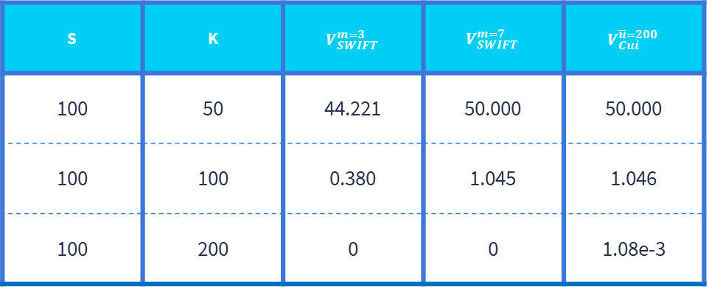
Stress Tests. $τ=2$ weeks.
S | K | $$V_{SWIFT}^{m=3}$$ | $$V_{SWIFT}^{m=7}$$ | $$V_{Cui}^{\overline{u}=200}$$
100 | 50 | 44.221 | 50.000 | 50.000
100 | 100 | 0.380 | 1.045 | 1.046
100 | 200 | 0 | 0 | 1.08e-3

Slide 47
Realistic Convergence Tests
 | Foreign exchange | Interest rate | Equity
Max absolute error in parameter estimation | 1.98e-3 | 2.66e-4 | 1.16e-3
Average number of iterations | 13.85 | 6.32 | 6.78
Average time (ms) | 334 | 194 | 201
Objective function final value | 2.87e-11 | 2.03e-11 | 3.64e-11

Slide 48
Conclusions and further research
7
Let’s start with the first set of slides

Slide 49
Conclusions
A complete extension of SWIFT for calibration is provided.
Cui’s Heston characteristic expression numerical problems are discussed.
The presented calibration method execution time is comparable to the highly efficient reference one.
Useful for supervised trading.
Insufficient for high-frequency trading.
Challenging volatility surfaces are properly calibrated in under 1 second.

Slide 50
Conclusions
A complete extension of SWIFT for calibration is provided.
Cui’s Heston characteristic expression numerical problems are discussed.
The presented calibration method execution time is comparable to the highly efficient reference one.
Useful for supervised trading.
Insufficient for high-frequency trading.
Challenging volatility surfaces are properly calibrated in under 1 second.
Further research
Extend SWIFT calibrator to other contracts.
Investigate alternative optimal parameters.
Apply the speed-ups to the reference calibrator.

